Slide 1
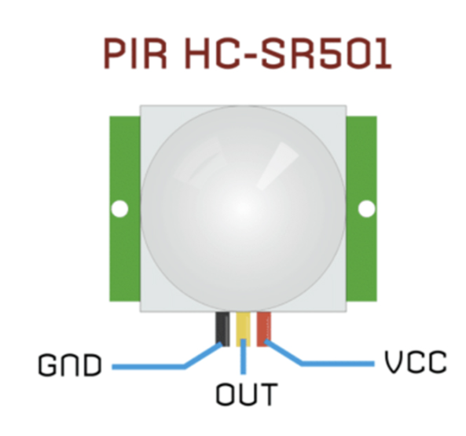
PIR – PASSIVE INFRA-RED MOTION SENSOR
-
+

Slide 2
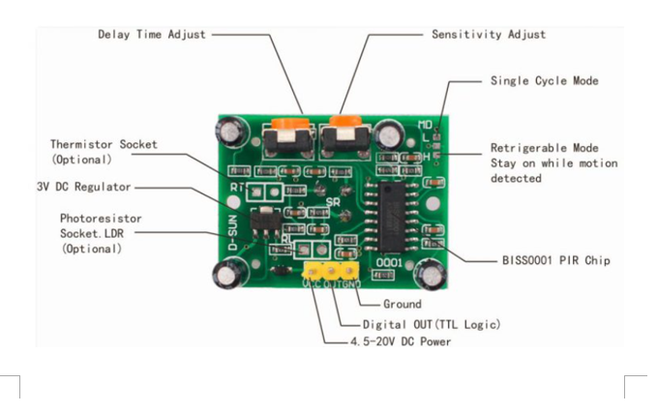
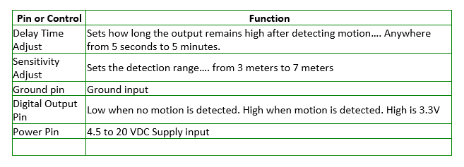
Some technical information
S

Slide 3
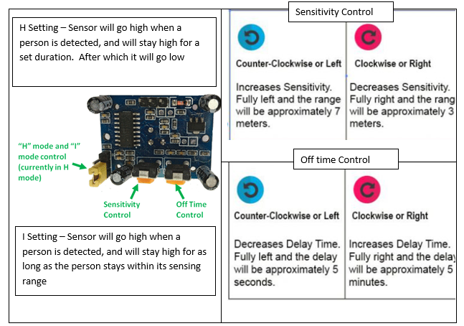

Slide 4
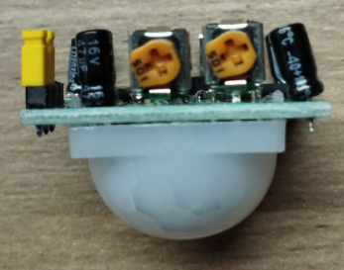
Tweaking the HCSR501 PIR SENSOR
Reference Point
Sensitivity Control – Distance at which
This sensor can pick up changes / movement
This setting, which have the control in the most anti-clockwise
position can detect movement up to 7 meters away. Whereas
the most clock wise position will detect up to 3 meters.
Set it to be too sensitive it will pick up unnecessary noise.
Time Delay
Most anti-clockwise position will give the sensor a delay of 5
seconds before it can be activated again. Most clockwise position 5 minutes.
Use a Phillips screw driver. Be Gentle

Slide 5
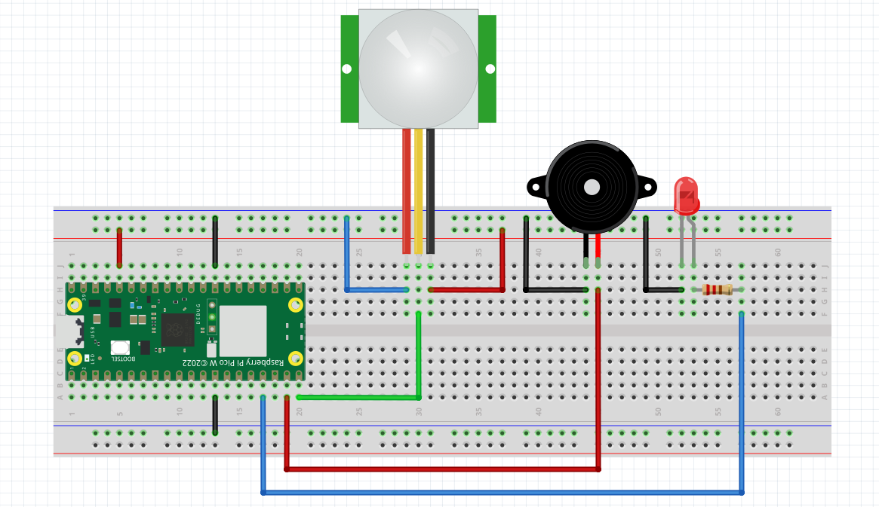
Ex 6 Using the PIR to make
A Simple Burglar Alarm
_
+

Slide 6
The PIR sensor makes use of the Pin function of the machine libarary
Just like the LEDs , Buzzers and Button.
In fact we can say that a PIR is like a button (a contactless button)
In our diagram the PIR is connected to Pin 15. This is how we set it up in code
from machine import Pin
sensor=Pin(15,Pin.IN)
To check if the PIR has detected movement, the code is like this
if sensor.value() == 1:

Slide 7
Ex 6 Complete the follow burglar alarm code on your own.
Requirement: When sensor is detected, light up the red LED and sound the buzzer
You will need the while True loop, if sensor.value() == 1:
from machine import Pin
sensor=Pin(15,Pin.IN)
…….
…….
while True:
……
……
……
Save code as ex6.py and RUN

Slide 8
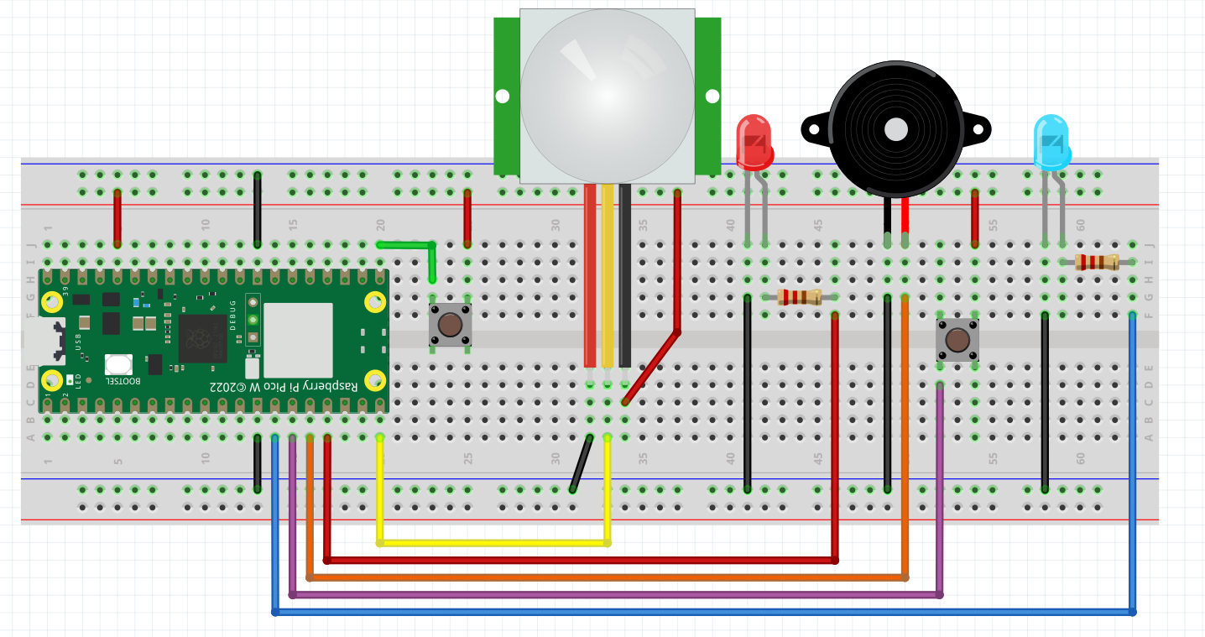
Ex 6a Using the PIR to make
An Enhanced Burglar Alarm
PASSIVE INFRA-RED SENSOR - PIR
_
+
+
PIN 16
RESET
ARM
PIN 15
PIN 13
PIN 12
PIN 11
PIN 10

Slide 9
Ex 6a. Enhancing the simple Burglar Alarm
A Burglar alarm should work only when it is activated
And should be deactivated when it is not required
Activated means armed_led is switched ON
RESET BUTTON PRESSED
ARM BUTTON PRESSED
WHEN MOTION IS DETECTED
ARMEDLED ON?
NO
PASS
ARMEDLED ON?
YES
PASS
ARMED LED ON?
PASS
NO
YES
NO
ENTER PASSWORD
TURN ARMED LED ON
YES
RUN ALARM
PASSWORD CORRECT?
NO
Ex 6a is just a revision for functions and conditional statements
Codes are provided on the next page.
Try doing it first on your own without referring to the codes in the cheat sheet
TURN ARMED LED OFF

Slide 10
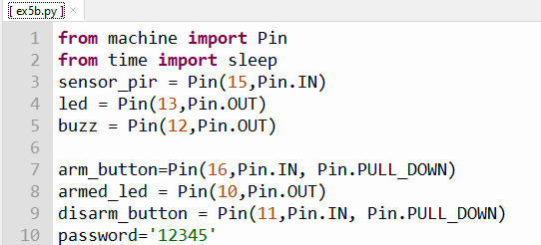
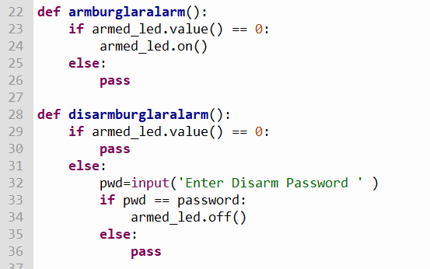
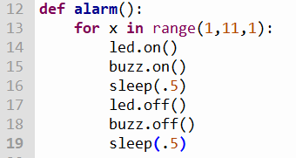
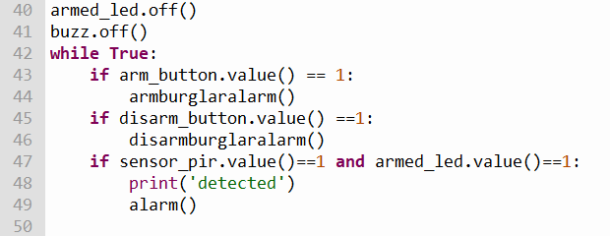
CHEAT SHEET FOR THE ENHANCED BURGLAR ALARM
burglar_with_machine.py

Slide 11
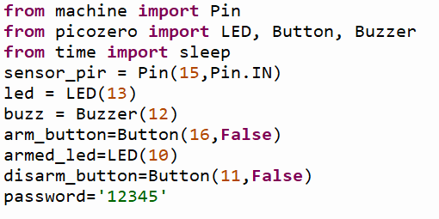
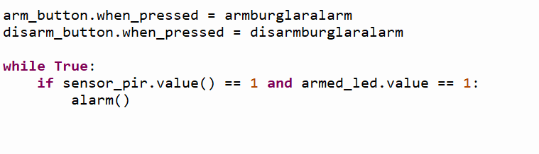
CHEAT SHEET FOR THE FULL FLEDGED BURGLAR ALARM
burglar_with_machine.py
See club’s github page
burglar_with_picozero.py

